Slide 1
DoS Attack with Slowloris
By Charles Bigger

Slide 2
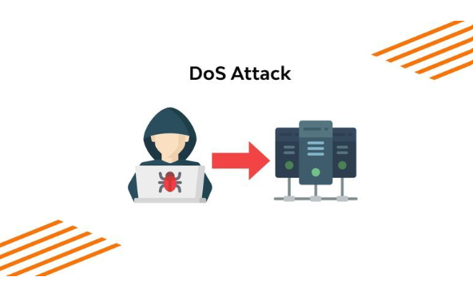
What is a DoS (Denial of Service) Attack?
A form of digital attack designed to occupy IT resources in effort to prevent genuine clients from gaining access to PC frameworks, organizations, administrations, or other information technology assets.
DoS attacks come in many forms but some common types are: buffer overflow, smurf attack, Ping flood, ICMP flood, and SYN flood.
These attacks can be completed using DoS methods which typically start from a solitary source or using DDoS methods which can start from multiple sources or a system of botnets and are generally harder to recover from.
Notes:
Wallarm, Inc. (2022, May 16). What is Denial of Service Attack (DoS)? ⚔️ Definition, Types. Www.wallarm.com. https://www.wallarm.com/what/dos-denial-of-service-attack

Slide 3
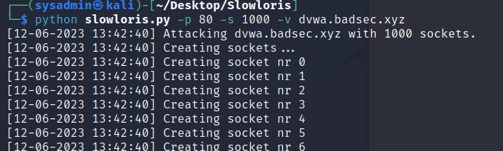
DoS Attack
During is single source style DoS attack, a hostile actor floods a website or network with socket requests in effort to overwhelm at assets ability to handle traffic and is commonly referred to as a flood assault.
With the flood of incoming requests the asset becomes unreachable to the victim causing disruptions in service.

Slide 4
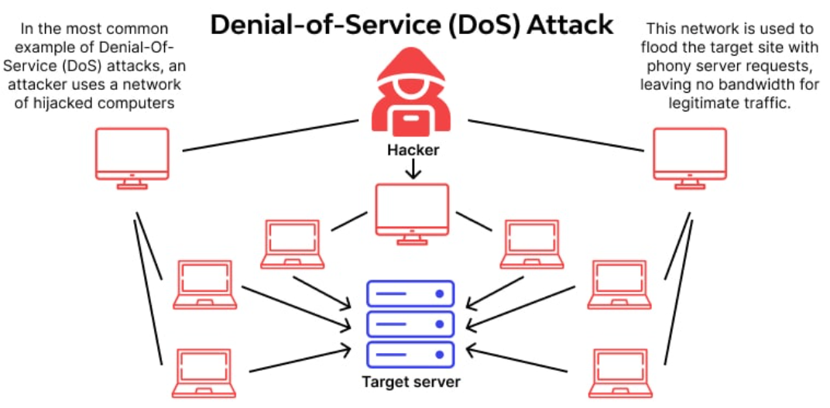
Attack Visualization
Notes:
Wallarm, Inc. (2022, May 16). What is Denial of Service Attack (DoS)? ⚔️ Definition, Types. Www.wallarm.com. https://www.wallarm.com/what/dos-denial-of-service-attack

Slide 5
Tools used for demonstration
DVWA installed on Kali Linux VitualBox - Target of the attack
NMAP - to scan for open ports.
LBD - to check for load balancing
Slowloris.py - Python script for running the attack.
Notes:
gkbrk. (2019, May 4). gkbrk/slowloris. GitHub. https://github.com/gkbrk/slowloris

Slide 6
DoS Attack with Slowloris Demo
Notes:
Using NMAP -sS flag is used to perform a TCP send scan and is considered stealthy due to not opening a full TCP connection when scanning.
The -T4 flag is simply the speed at which the scan is running which ranges from 0 to 5. Zero would be the slowest and most stealthy and five would be the fastest and most obvious.
Using LBD scan which stands for Load Balance Detecting and comes standard on all Kali Linux distributions.
Slowloris is a Python script available on github. Using the -p flag tells the script the port to attack and the -s flag delineates the number of open sockets to use in the attack. I have also used -v for verbose so we can watch the attack.

Slide 7
Effects of the Attack
Common signs that a DoS or DDoS attack has begun are:
Operating system suddenly becoming sluggish
The inability to navigate to any site.
Or the complete inaccessibility of a specific site

Slide 8
Mitigation of the Attack
Identify public facing services and prioritize them based on mission criticality and employ a web application firewall (WAF) appropriately.
Enroll in a dedicated DDoS protection service.
Design networks with high availability and/or load balancing features.
Develop an a DDoS response plan.
Run table top exercises and regular tests to ensure that participants know there roles and there are no gaps in the plan.
Notes:
Cybersecurity and Infrastructure Security Agency. (2022). Understanding and Responding to Distributed Denial-of-Service Attacks. https://www.cisa.gov/sites/default/files/publications/understanding-and-responding-to-ddos-attacks_508c.pdf

